Slide 1
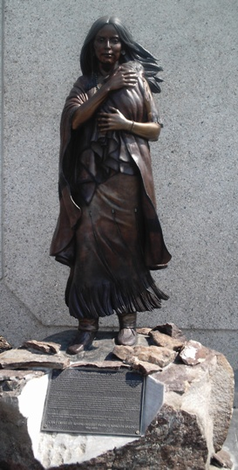
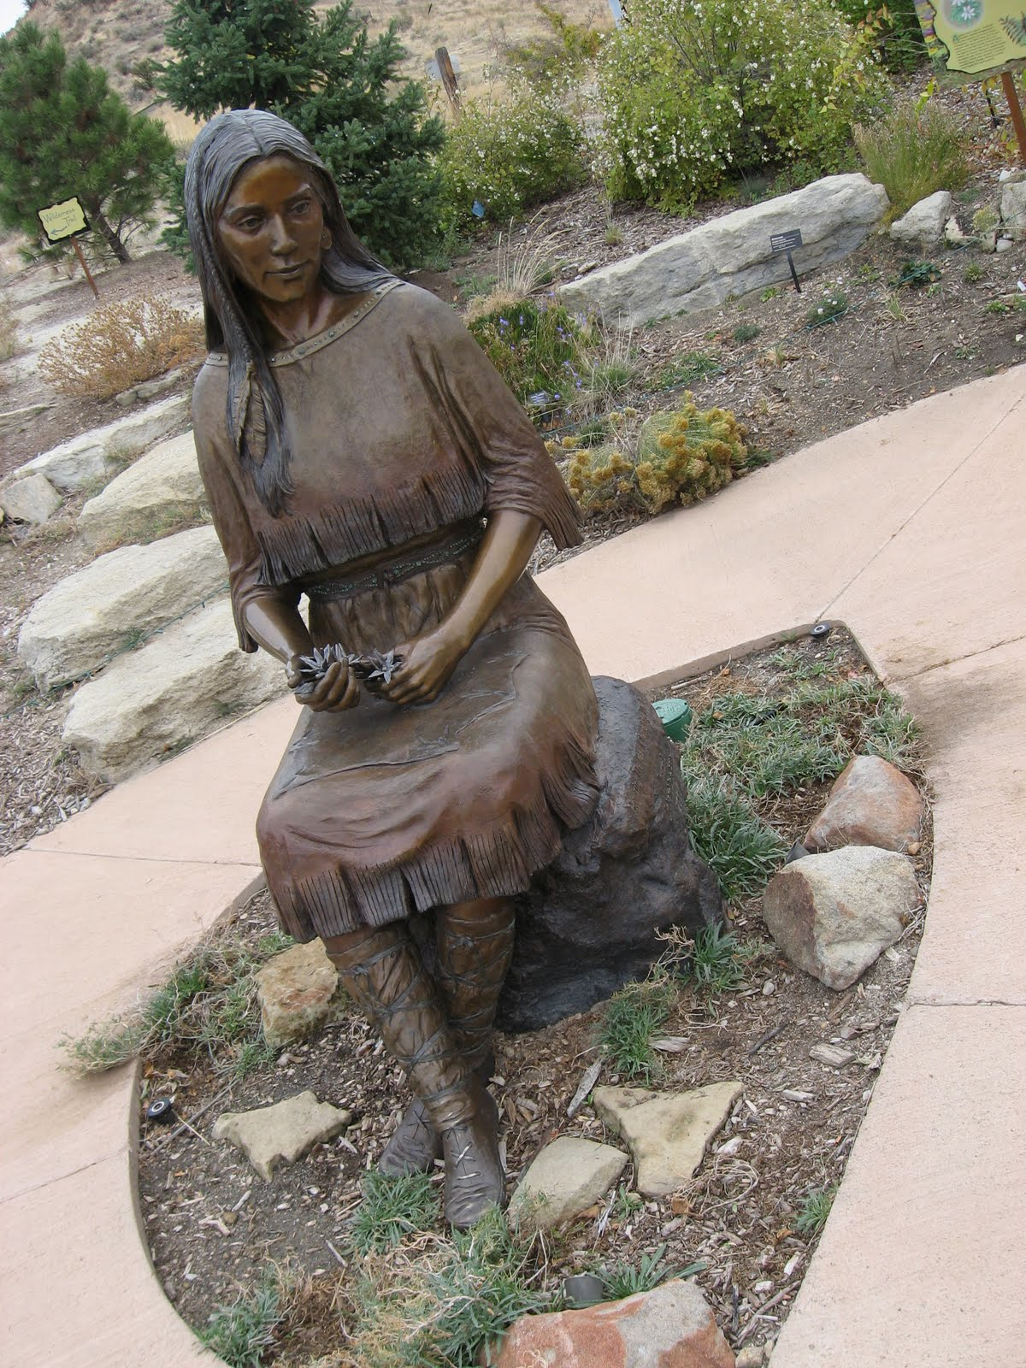
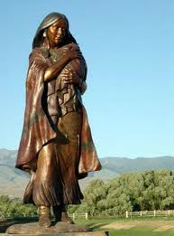
Idaho’s Sacajawea Statues

Slide 2
Students will be able to:
Provide examples of Sacajawea’s role in Idaho’s history through class discussion and utilizing the “Sacajawea 2005…” article.
Summarize and better understand the article “Sacajawea 2005…” through the use of the Marking the Text exercise.
Write two short journal entries answering essential questions from the Sacajawea video.
Write a one-page fictional letter to President Jefferson from Sacajawea’s perspective summarizing her role and it’s importance in the Lewis and Clark Expedition.

